Slide 1

ERP System For Institutes
Raman kumar Student ID U2173241
University of Hudderfield Dissertation

Slide 2
Abstract
ERP solution OPEN source which only support manufacturing and industrial applications, so the predefined dataabase applicaiton which does not meet the exact educational requirement, in previous ERP solution which has various complexity and issues due to poor software planning of the system since Java, C# APS and C++ which does not support the ERP solution in organized way due to complex programming system, so python flask web based application works efficeintly and well to support MSc student program based on semester system, this ERP solution only deal with MSc program student of computer program.
Python flask is light weight micro web application which is fully integrated with MYSQL database system to store the sutdent login records in real time. Student logged into the system to view their educational resources such as assignment, and lecture notes, PDF lecture and Video lecture is main agenda solution to meet the research gap.
This reseach combines all modules functionality in one layer which support login based solution that contains all educational helping material, lecture slides etc. Faculty and student meeting time is also displayed on the top, hence regular class schedules is listed there.
Technical literature reivew has been conducted in comprehensive manner to reivew the research gap and issues, the idea is coming from literature to develop python application which has novel framework intregrated and managed easily on the top.
This research does not harm any human during research findings, so this reserach works is not part of any profit and funding agency. Its only support disseratation requirements of academics.

Slide 3
Chapter 1: Introduction
Enterprise resource planning system control various educational resources , it encourages students to login to ERP portal to executes theri educationl resources. (Sun, G., Huang, Z. and Yue, L., 2022) this project going to develop the ERP system proposed on python Flask web application which complete with MYSQL server database for recording the student information. Flask is micro web framework of python which is better than DJANGO, it contains render templates to execute HTML and CSS files using the main root directory of python application.
This project using the advanced programming technique including user friendly management of resources such as login page, sing up page and home page. This project only focused on MSc computer science student which comprised of semester system. It facilitate the overall MSc degree program content composed of assignment, lecture notes, lecture slides, video lecture, lecture schedules and faculty meeting time which is designed according to the time period. However the educational resource management approach based on model selection which process the backend query on database server engine.

Slide 4
Common features of ERP software in Higher Education
Admission Management
ERP software eliminate the manual admission process which are based on basic files and folder system, since the common features of admission system are based on student academic documents and student information record keepings since the application processing and registration processing which are integrated on email and SMS functionality.
Attendance Management
Integrate student’s daily schedules and track of student attendance, creating student report and attendance which are managed through SMS and Email system alert system.
Tuition Fee Management
Creates multiple plans for different student courses, new student enrollment process manage and organized by ERP software such as multiple plans, track payments, generate receipts.
Alumni Management
Create, maintain and update alumni database the online creating which process on registration process.
Curriculum/course management
ERP software enable them to capture different payment and enrollment processes. Online curriculum and syllabus management which are dealing on different objectives.
Faculty Management
Manage and organize faculty management which process all faculty queries and task.
Student information / record systems
Create and maintained the detailed student profiles which are generates student id, with unique student id, name, address, and integrate student information system, since the student information system is used for record keeping purpose.

Slide 5
Aims & Objective of Research Project
Aims of this research project to develop ERP solution composed of Flask web framework and objective achieved on the following parameter:
By developing python flask web framework composed of render html template which designed on MYSQL database platform to record the student profile.
Deploying the Bootstrap web application framework to design student signup and sing in page which essential elements of every ERP to manage the user session.
Conduct critical literature review composed of latest ERP solution.
Develop Flask Solution to achieve the MSc student studies content in order to achieve the project timeline.
Develop lecture and studies material based student profile which designed on single user login platform which meet all the business and educational requirements.

Slide 6
Chapter # 2: Literature Review
Related Work
(Soliman, M. and Karia, N., 2016) in Egyptian higher educational institutes ERP system implementation which necessary requirement of educational need, since enterprise resource planning manage student query, organized fee system, manage student programs and faculty issues. ERP system improves efficiency and enhance educational operations with assistance administrative of education institute. Since it has been investigated that ERP system able to did all educational operation in one platform either faculty query, student query operation and administrative feedback with assistance of educational schools, since the every educational school have their own requirement, so the requirement is different and all operational efficiency has different from one another. (Abugabah, A. and Sanzogni, L., 2010) enterprise resource planning system to executes all operational of education institutes since it was not functional well due to lack of business requirement and educational requirement, aim of this research to explore the issues in the previous ERP system, since this research focused in educational system in Australia, hence ERP particular references with user interface to process complex query and operate different module, this research investigating only literature finding based solution. (Allen, D., Kern, T. and Havenhand, M., 2002) ERP critical success factors this research exploring contextual factor composed of public sector educational institutes

Slide 7
Conclusion of Literature Review
Python Flask Features
Python flask easy to develop web based application, it is much better than DJANGO framework
Python flask is more better than Java framework due to less coding
Flask using the Jinja2 template engine
Flask deliver HTTP request support
The literature finding are composed of ERP solution for academics and it’s also investigate with other ERP solution that facilitate, industry, sales, manufacturing, business etc. Since previous ERP for Educational institutes were not stable and not actively well, previous Java and ORACLE used but still issues and problem exists, research gap identified that FLASK base pure python application does not exist in previous literature studies so this research going to present unique and new development with advanced programing feature that support SQL function with POSTGRESQL in python flask framework.
MYSQL database Xampp server
Python FLASK framework
HTML CSS JavaScript

Slide 8
Chapter # 3 Methodology
Research Strategy
Python Flaks
MYSQL DB
HTML CSS & JavaScript
Python libraries
Notebook & Pycharm
Python Flask
Flask is micro web framework essentially part of python language, flask is better than DJANGO because of module conversion and application execution environment. Flask itself is python library of web, which import web layout framework during application running, flaks run like app in the python module, since flask application embed HTML and CSS JavaScript in order to make comprehensive application. Flask application executes on local host 127.0.0.1:5000, debugger is active and debugger pin code is 855-212-761.
ERP in Flask
Enterprise resource planning system generate by using the web framework of python flask, including database connectivity to store and executes the student and faculty record. Since ERP system is part of business process management which allows academics to use system and integrated application including office files and desired data to be process in system

Slide 9
Data Collection Method
Research Data:
Secondary research data collected from Google Scholars, IEEE, MDPI, ACM library, JSTORE etc.
YouTube Video Tutorials:
Creating python application enterprise resource planning, this project taken help from YouTube video tutorials.
Research Positivism
Research positivism the approach of this research project scientifically proven by programing based experiment which helps the academics society to control and managed their educational resources in better environment. This research does not go beyond the boundary in which the society does not like to analyze.
Research interpretivist
This research analytical making practices of educational resources in real life practical solution based in which educational society would be beneficial to takes interest to enhance their educational resources through programing structure. Research project showing practices and practical interface between the student and faculty which showing positive interest in our society which generate observable outcome.

Slide 10
Chapter #4: Result & Analysis
(Vogel, P., Klooster, T., Andrikopoulos, V. and Lungu, M., 2017) low effort analytics platform which analyze & visualize, web application are written in python flask programing since POSTGRE SQL database communications might be crashed sometimes alternative way to construct database with MYSQL server using Apache Xampp server technology. Flask is python web based framework in which ecosystem extension support developer application which are performed better comparative to previous web framework using Java, C#. flask library integrated with all web programming modules such as html, CSS & JavaScript, which perform better web experience fast, integrated reliable and achievable. (Mufid, M.R., Basofi, A., Al Rasyid, M.U.H. and Rochimansyah, I.F., 2019,) designing of model view controller which composed of CRUD operations, flask is micro web framework using the python language which is easy to understand and easy to implementation comparison to C++ and Java Programming, since if comparison with C# ASP.net python is better programing in all language platform.

Slide 11
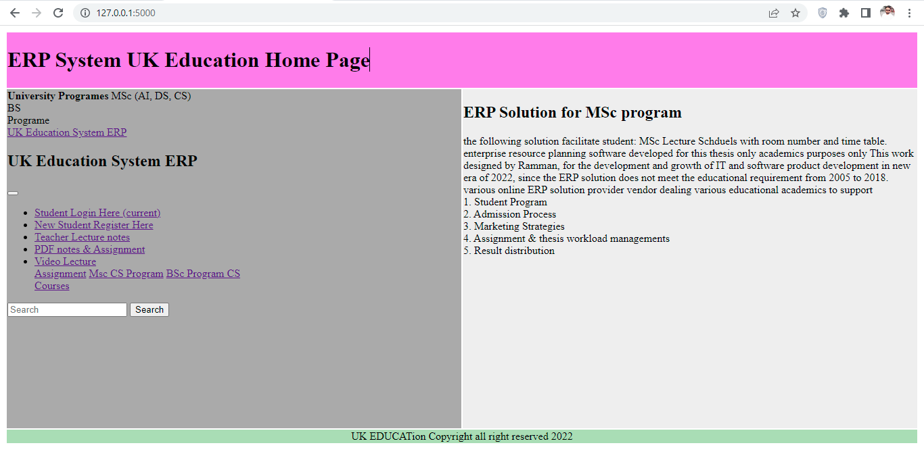
Result of Python ERP

Slide 12
Python ERP Flask objectives
The objective of this Python flask application equipped with HTML & CSS bootstrap application, since bootstrap quickly used to create the html &CSS web pages quickly, its support to develop web application python bootstrap plugin is major component of this project, to implement project by using the bootstrap plugin including html & CSS layer. Bootstrap plugin easily installed in python Pycharm by implementing creative web sheet awesome font’s style and background color. Web page layout also created by the bootstrap system.

Slide 13
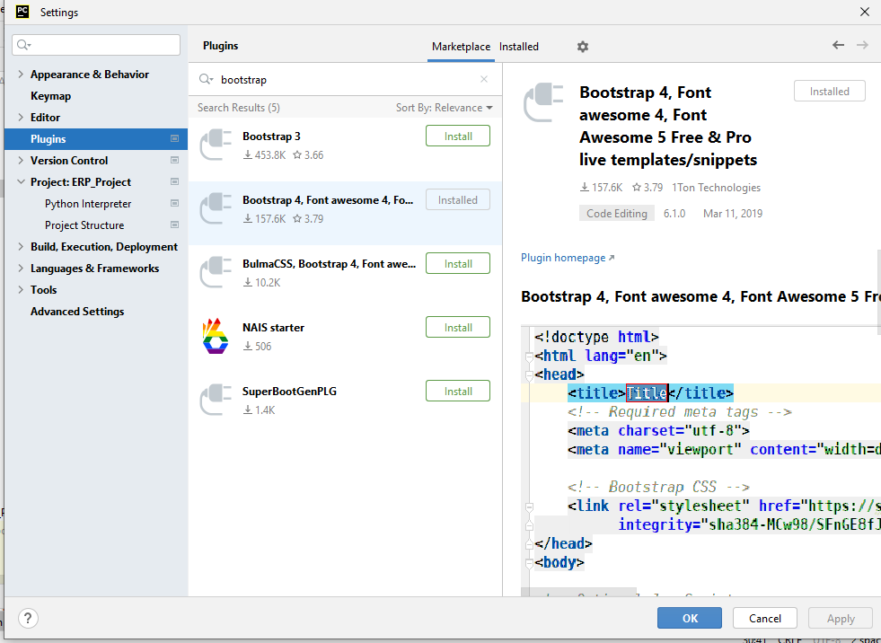
Bootstrap plugin Pycharm

Slide 14
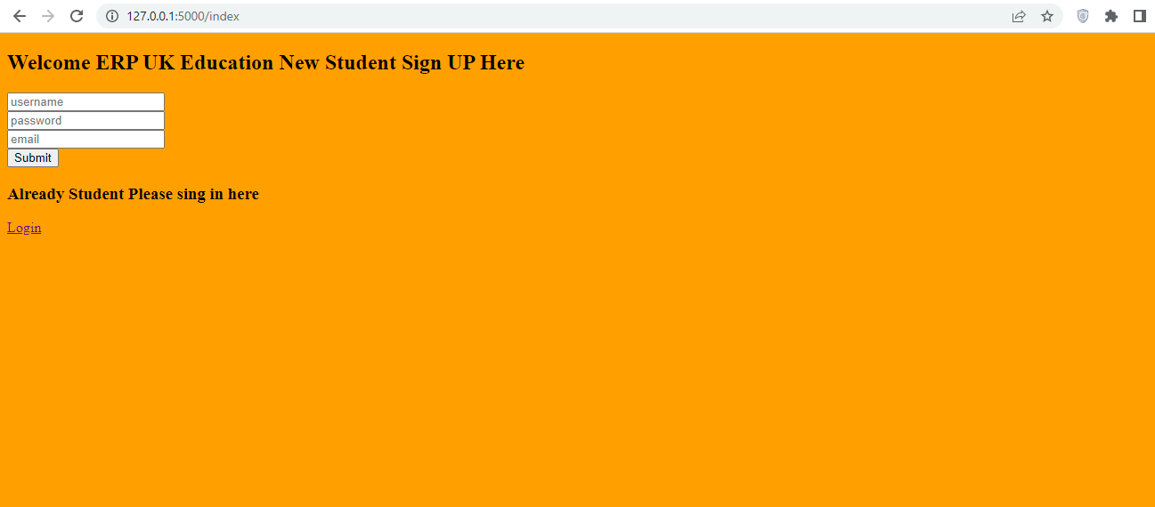
Register User page

Slide 15
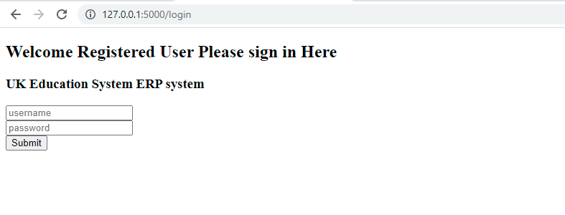
Login page

Slide 16
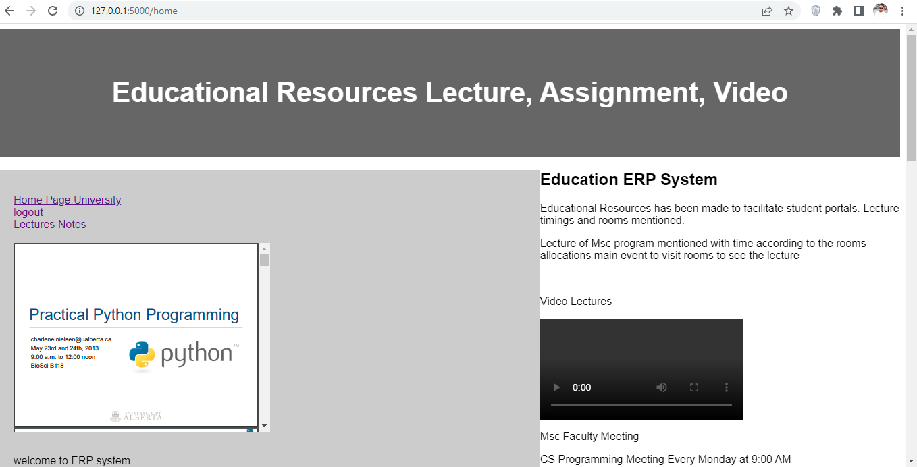
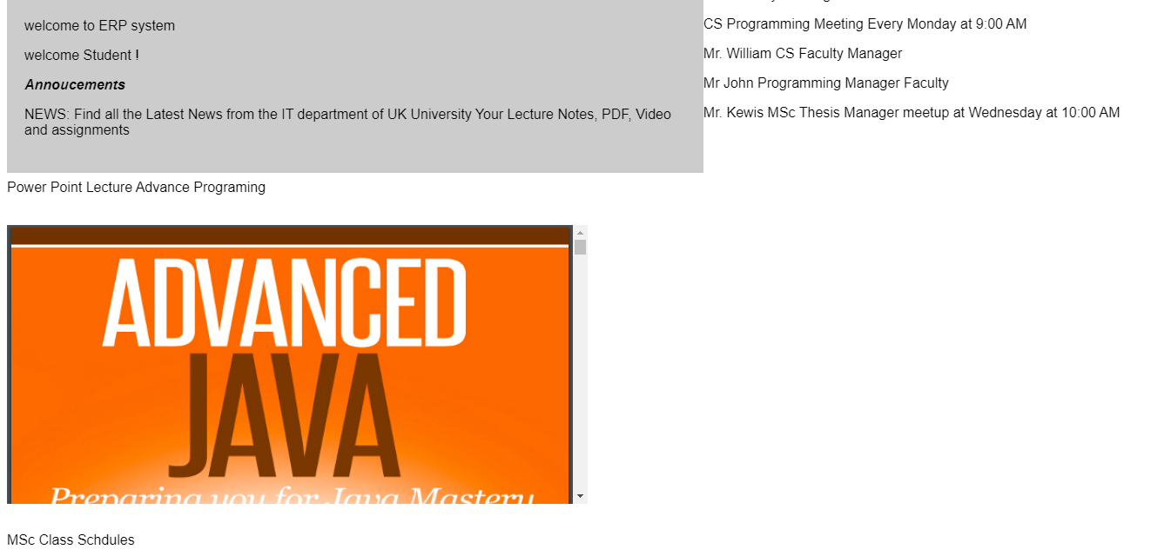
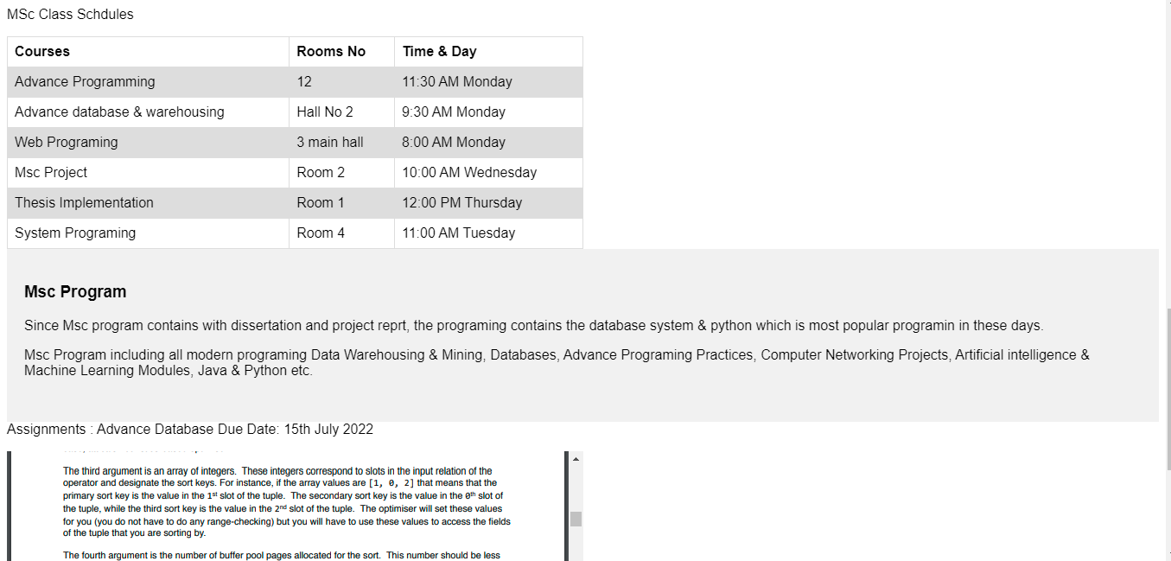
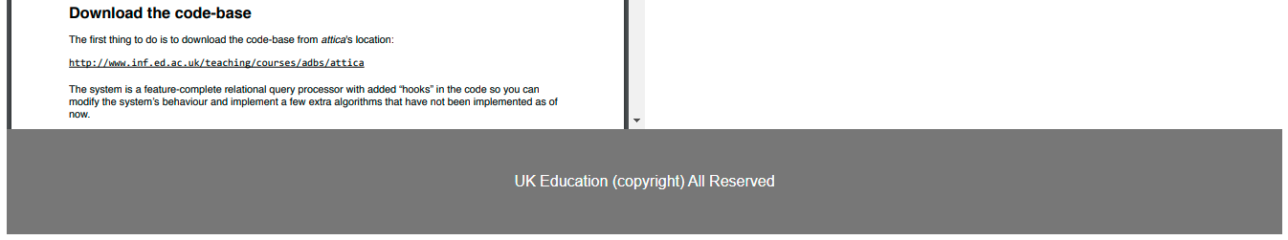
User Profile Page:

Slide 17
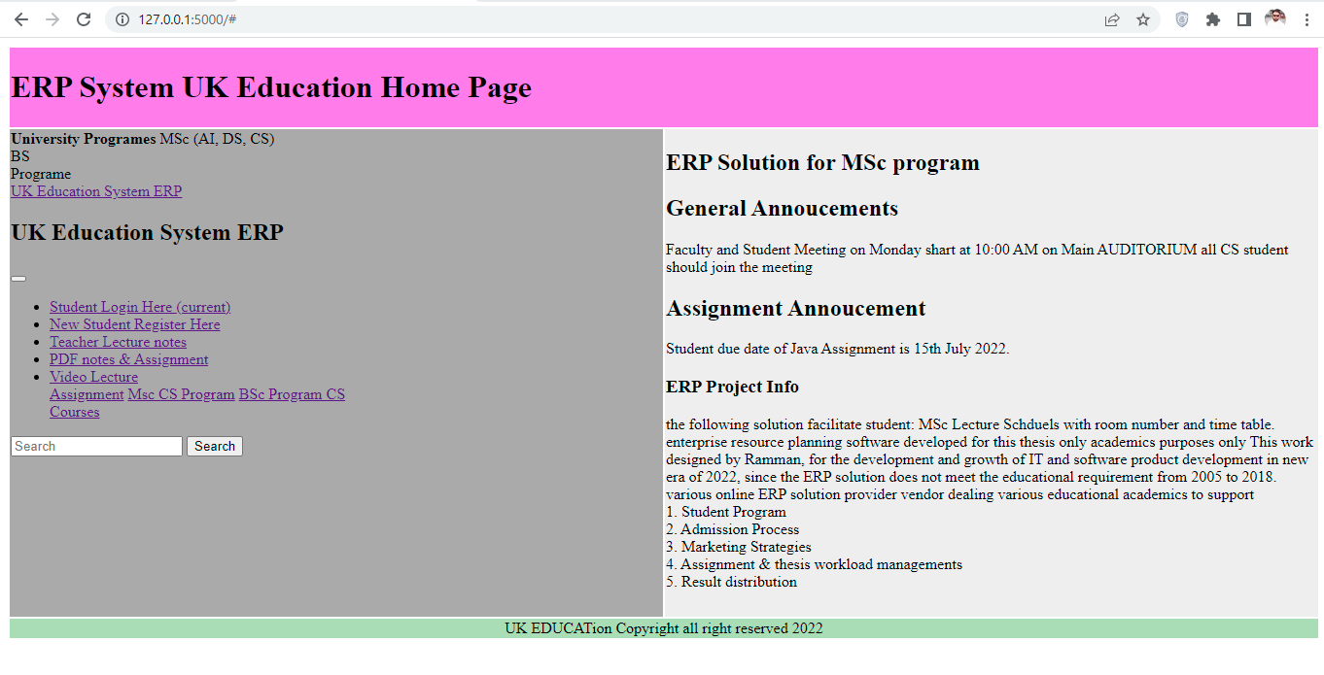
Logged out to get home page again

Slide 18
MYSQL Database
MySQL database is most commonly used database in the system which enhance the implementations of educational resources in the backend. (El Mohadab, M., Khalene, B.B. and Safi, S., 2017) integrated business process related to fee submission of student has been resolved by ERP system using the online system. Integrated intelligence areas such as workflow, management communication processes which organize to enhance the functional area. The reason to choose ERP software which delivers the competences, hence reason to choosing the common database which support all process management backend control and record keeping purposes.

Slide 19
Database creation process carried out as follows:
Create new database → flaskdb
Create new table → users
Add attributes name and data type values in the table as clearly seen below:
Id: int length 11, name: varchar length 150, email: varchar length 150, password varchar length 150.
SQL query processing system works efficiently to process the database query.
Database import/export process which integrate to export the project to another location and computer.
Database running in localhost.
Browse the query to delete the recorded entry in the database system, recorded database delete when the information is not required.

Slide 20
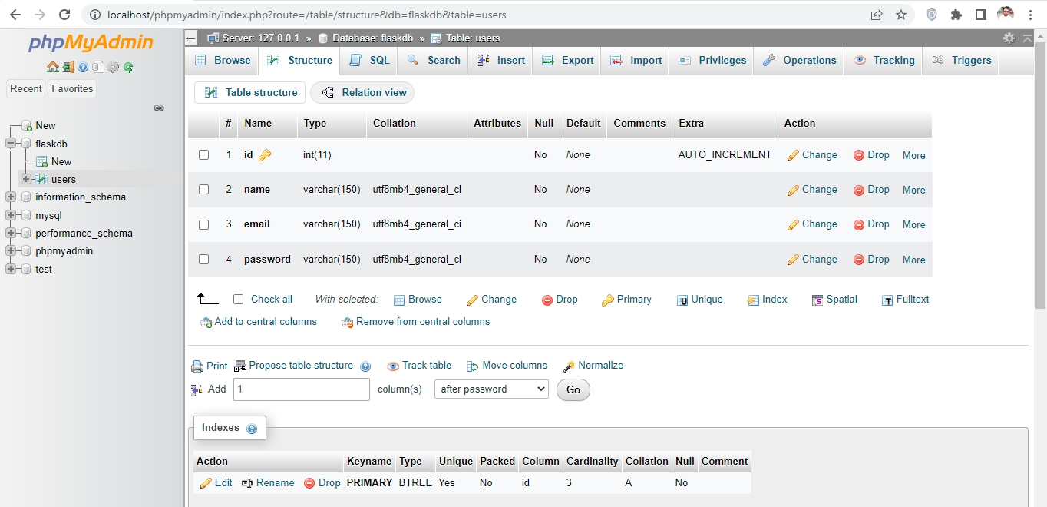
Phpmyadmin

Slide 21
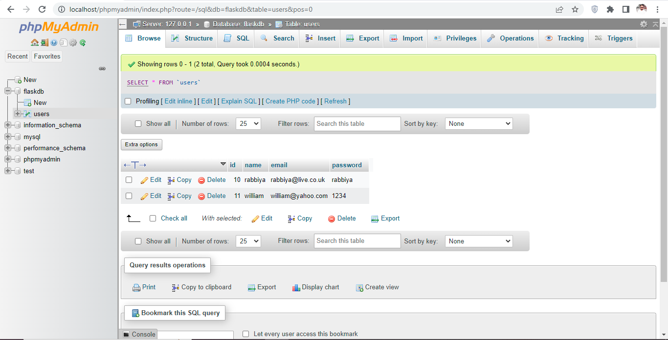
Database Records

Slide 22
Python ERP Project
(De Carvalho, R.A. and Monnerat, R.M., 2008) deployed previous project in python programming hence this project is more efficient than previous one, implementing enterprise resource planning projection which capture the necessary information in order to process and reflect the code.
In this project the coding process admired by python main file which used to execute the app route files using the python main function. Render templates contain html & CSS files.
The following templates executes from the main route ERP files as follows:
Main HTML
Signup HTML
Home html
Login html
404 html
Style css file
In the login and registration process the post method implemented to process the query in the database system in MYSQL system.
Python login and login check function implemented to verify the login credentials entered by user during the login process.
Main app route file executed through render templates which contains html main file.
CSS templates followed from the Google bootstrap sites. (bbbotrap 2021)
HTML coding sequences followed from the bootstrap template (getbootstrap 2021)
Python coding implemented by learning video lectures from YouTube video tutorial sites.
Python implementation has been carried out to resumes all the functionality through the protocol layer of 5000 by running the flask app in the browser though local host.

Slide 23
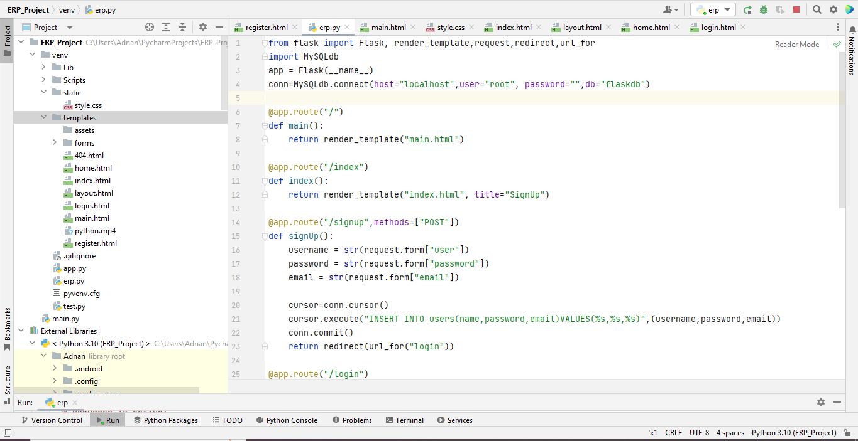
Python Code Review

Slide 24
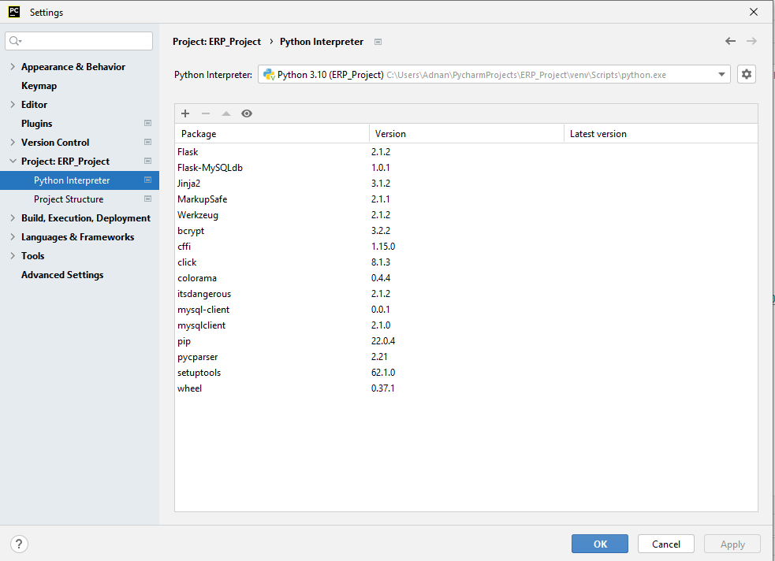
Python Packages at Pycharm community

Slide 25
Critical Analysis
(Mutongwa, M.S. and Rabah, K., 2013) ERP system solution proposed to process the small and medium task on web which facilitate the educational resources, hence ERP is integrated information system, the increasing demands of ERP system which integrated with various module, objectives of this research to develop ERP system to process small and medium enterprise industries, but comparison with education system needs to refurbished them. (Zhou, C., Zhou, T. and Bai, W., 2018,) key finding of this project to implements smartphone NFC technology using the ERP system hence the near field communication which is based on short range communication technology which combines the ERP data streams on the phone. This research using the cross platform third party tool to support android phone user which customized short range communication method to view ERP resources on their telephone screen. Since the security of short range is challenging to secure the end to end encryption.

Slide 26
Sentiment Analysis
This research proposed (Sarlan, A., Nadam, C. and Basri, S., 2014) twitter sentiment analysis based on machine learning method, twitter is most common social media platform backed process by enterprise resource planning system on regional based, result carried on python DJANGO framework to analyze the positive and negative feedbacks of customer on twitter database.
11.2 Enhancing Automation using python code Injection
(Novak, P., Douda, P., Vyskočil, J. and Wally, B., 2021) industrial 4 revolution corresponding to preproduction processes under production resource process. Automation process carried out using python script injection to represent needed information on the web which demonstrate industry 4 testbed

Slide 27
Higher Education ERP Solution
Since python enterprise resource planning system to reach the educational goal, since the python programming, school administration, human resource and financial management, higher education system support academic, process in colleges and universities such as exams, grades, tuition building, billing to scheduling the process over the administration process has been maintained through the ERP solution which previously design on administration process to mitigate the schemes. The administration process which organized the mitigation process academics college administration nature running educational, the educational resources to process which holds the several processes the operation process has been discussed and planned according to the nature of business theory.
Since the academic solution are designed to process the educational resources, several educational resources organized, teacher administration and beyond. Fully integrated process vendors talking universities to view the complex project. Student, teacher and administration best-practices for best administration to control the process.

Slide 28
Features of Higher Education ERP systems
Student information system since the stored procedure details of students, allow the student to register for classes, the administration process organized managed through to manage the track institutional goals. Since the human resource management are designed to organize and managed the different objects. The time sheet, leave request and compensations which identify the right candidates via talent management, track the tenure system which process the different complex task, since the financial services managed through the organized projections educational institutes, budgeting, payroll, payable account, procurement and requisition and grant certifications. Financial aid management. Handle awarding to review the payment process, their account the calculations of organized task which analyze the report which needs in robust manner

Slide 29
Benefits of Higher Education ERP Systems
The benefits educational ERP system institutes helps to achieve the certainty of different objects, since the objectives of higher education system has been maintained by IT administrator to enter the student managing since the university library system has been organized managed through the centralized which including fee processes, monitoring the student grades and sending the query which are maintained by the information management system. The college and university system has been implemented and proposed by university administration to achieve the certain complex task based on admission process, student enrollment process, fee processing, hence the alumina process the higher education studies schemes the college community organized with several task to obtain the better result which are proposed on objective themes of business operations. Some of the top benefits of ERP education system which are used to obtain the better result such as largely privately running private application to draw the attention which are organized to meet the business objectives. Since the top benefits of higher education ERP system proposed on different attribute based object classification method which meets the student and faculty requirements.

Slide 30
Manage Student information effectively
Colleges and universities which needs higher education to compete the business processes to achieve the business logic operations. The correctly deploy ERP solution which are proposed on best programming logic to enable them the collected data and information to process the certain task in order to maintain to process the data and information. The academia management solution which learning on certain objects to classify the certain objects to meet the objectives of business logic. The business requirement would meet the business logic requirement since the ERP software implementations to organize the business logic operation to process to organize academics.
The compliance business requirement which meets the educational requirements to meet the certain objects, since the educational ERP implementation system, the digital implements should be maintained on the business logic operations. Since the truly implementation of ERP solution which meets the business logic operations to process the several complex task on the desired requirements of internal operations. Communication business logic operation processes on higher education system to process the several business logic operations since the several communications process has been maintained and process the educational resources previously attempt to achieve the business logic operations. The departments of college which actively works to achieve the certain object based classification to design the business operations.

Slide 31
School Management System
School management software system which automate the business logic operations to process the involved tasks which are running by educational institutes, since the higher education ERP software system executes all schools requirements which are based on the business logic operation and student admission process leading towards the student enrollment process. Higher education learning process which are used to organize the systematic approach of business classification to achieve the object classification models related to secondary data model. Various refers to ERP software classification which achieve the business model that executes the certain task on intent based software classification, since the true implementation of ERP solution are designed to minimize the business complexity by achieving the certain objects based task execution, the object based classification are executed on different modules based segmentation, K-12 schools which are needs to classify the universities school object classifications on the certain object based execution modeling since the intent classification pattern achieve the model testing goals to draw the attention of university administration processes.
Student information System
Student information system of MSc level which are available on ERP software by achieving the several complex tasks, student access their records by achieving the certain to apply the several which in view to draw the academic services, review the business operations which achieved the educational resources to achieved the tasks, semester course offerings are designed to meet the desired educational requirement on certain parameter.

Slide 32
School administrative software ERP
Since the school administrative related query are processed and executed by student faculty management to achieve the business operations. Administration and schools attendance system executed by the departmental management, faculty management, even the student health record management, hence the university administration process achieved through the several business logic layer and student information system logic layer and modules which executes both of the task to facilitate the student community in real time. Educational resource management system proposed the maps to draw the systematic approach to meet the business operations which are based on organized systematic approach, since the objectives of higher studies is achieved through the certain business classification to enhance the finance flow, the ratio of maximum admission process. The university administration would takes interest by marketing campaign which also organized by the ERP software solutions, since the implementations of ERP software should maintained through the web based ERP solution which executed by different student based on different domain based executions. Since the implementation of ERP solution also energized the business operation to meet the certain task of business layer. Since the real implementation of ERP solution which would designed by software developer which are based on business layer to meet all the necessary requirement that are deal by the university admission system.

Slide 33
Chapter # 5 Discussion & Conclusion
Python application works efficiently due to its ability of integrated online libraries, enterprise resource planning application organized and manage the educational resources. Python flask which is web framewrok to process the resource planning task to support educational requirement to executes resources on web based application. Previous ERP was very complex and not accurately works well, due to lack of educational requirments hence oracle database applications which is more complex to organize the systematic task. Online open ERP system is not match the educational resource planning requirement which is not working well. Beside this Amazon, ORACLE, Azure, IBM cloud providing cloud based online enterprise solution which is much costly and which does not meet the student and faculty requirement to process the educational needs. Since overall educational resources system change their requirement on frequent time which adds more complexity and complex features, so enterprise solution changing & modification permitted in order to increase the criteria.

Slide 34
Comparative Discussion of Open Source ERP Software
(Bajaj, S. and Ojha, S., 2016) in today worlds ERP system is much complex to meet the business needs since ERP solution is solution to solves all business needs which has integrated on various business functions. ERP solution which support small and medium enterprises organization, ERP5 is fully featured open source online ERP solution which meets the business requirement which providing the industry solution with more than 300 employees in 5 different global cities. Common functions of ERP5 is as follows:
CRM customer relationship management
Product Data Management
Manufacturing requirement planning
HRM
E-Commerce

Slide 35
TINY ERP (OPEN ERP)
Tiny ERP is known as open source ERP solution which are available on desktop edition and android mobile edition to support different kinds of problem, the architecture and styles of TinyERP is like open ERP solution constructed like SQL database functions.
SQL ledger
SQL ledger is web based ERP solution system which executes on windows operating system and Mac system which support small size and micro size organization functionality. Hence the entire system of SQL ledger which linked through the chart like inventory and accounts functionality mostly support finance application in common.

Slide 36
Automated Software Architecture Security Risk Analysis
(Almorsy, M., Grundy, J. and Ibrahim, A.S., 2013) reviewing the literature which suggest some comprehensive solution to meets the desired requirement according to the functionality of system development hence the software development life cycle needs security life cycle to secure the internal file system of ERP software. Since object constraint language (OCL) which uses the signature to target the system to locate signature matches and capture the internal data of the system and spoil them in bad manner. Since NIST security principle which attacked on database system based on CAPEC, so needs to improve them in order to run the software more appropriate manner.

Slide 37
Effective ERP Solution based on Case Studies
(Grobler-Debska, K., Żak, B., Baranowski, J., Kucharska, E. and Domagala, A., 2021) ERP solution composed of decision making solution which process customer, handle product manufacturing process which also suggest solution based on different complexity. Hence the application of POLISH company which uses the mass customization pharmacy industry to process medication requirement.

Slide 38
Conclusion
It has suggested and recommended from various previous researches that OPEN source ERP solution which support only industrial application such as small and medium organization. Since large organization required customized ERP solution based on real python programming which meet the requirement. OPEN source ERP solution which does not meet the educational requirement in real situation. Python Flask application is best choice to predict and analyze the student problem to model educational resources in more effective way.
Python and MYSQL database system works very well to organize the MSc program enterprise resource planning applications. It has been recommended that the requests is decent to used and easily configure and wieldy. It has been noted that the student would enable them to achieve the systematic approach in order to maintain the teaching objectives, syllabus progress updated on priority in which the different teaching fellows query has been maintained them. Since the modern ERP software is based on modern online database storing system which stores teaching records on online database system, it has been noted that the each professor answer the student query instantly by deploying the online system. The target and assigned teaching objectives has been achieved in which the teaching and learning objectives has been achieved on the following parameter to answer the query. Educational enterprise resource planning system enable them to captures the systematic and organized approach to maintain the teaching progress on priority.

Slide 39
References
Soliman, M. and Karia, N., 2016, March. Enterprise resource planning (ERP) systems in the Egyptian higher education institutions: Benefits, challenges and issues. In International Conference on Industrial Engineering and Operations Management, Kuala Lumpur, Malaysia (pp. 1935-1943).
Abugabah, A. and Sanzogni, L., 2010. Enterprise resource planning (ERP) system in higher education: A literature review and implications. International Journal of Human and Social Sciences, 5(6), pp.395-399.
Allen, D., Kern, T. and Havenhand, M., 2002, January. ERP Critical Success Factors: an exploration of the contextual factors in public sector institutions. In Proceedings of the 35th Annual Hawaii International Conference on System Sciences (pp. 3062-3071). IEEE.
Pollock, N. and Cornford, J., 2004. ERP systems and the university as a “unique” organisation. Information technology & people.
Klaus, H., Rosemann, M. and Gable, G.G., 2000. What is ERP?. Information systems frontiers, 2(2), pp.141-162.
Surendro, K. and Olivia, O., 2016. Academic cloud ERP quality assessment model. International Journal of Electrical and Computer Engineering, 6(3), p.1038.
Noaman, A.Y. and Ahmed, F.F., 2015. ERP systems functionalities in higher education. Procedia Computer Science, 65, pp.385-395.

Slide 40
THANKS

